Slide 1
SIEMENS-AG-56358595
Siemens AG is among the 1st world manufacturers of electronic and electrical equipment.The CA (before intragroup eliminations) by family of products is distributed as follows: - Medical equipment (30.1%): medical imaging systems, laboratory diagnosis and hearing aid systems, etc.; - Industrial digital equipment (27%): automated production, assembly, logistics, supervision systems, etc.; - Solutions of intelligent buildings and infrastructure (24%): energy transition solutions, climate engineering products (heating, ventilation and air conditioning systems), building safety systems (detection and protection systems against theFire, access control, video surveillance and intrusion detection, etc.), technical management systems of buildings, etc.; - Mobility solutions and systems (13.4%): rail vehicles, rail automation systems, rail electrification systems, road traffic management systems, digital solutions and cloud -based, etc. The CA balance (5.5

Slide 2
Suite :
%) concerns in particular financial activities (leasing, financing of equipment and projects, financial consulting services, etc.). The geographical distribution of the CA is as follows: Germany (16.6%), Europe- community of independent-Africa Orient (29.9%), United States (24%), America (4.7%), Asia and Australia (24.8%).Number of employees: 316,000Capitalization, business value, turnover, EBITDA, EBIT, EBT, net profit, debt and net cash, free cash flow, equity, total assets and CAPEX are in millions.

Slide 3
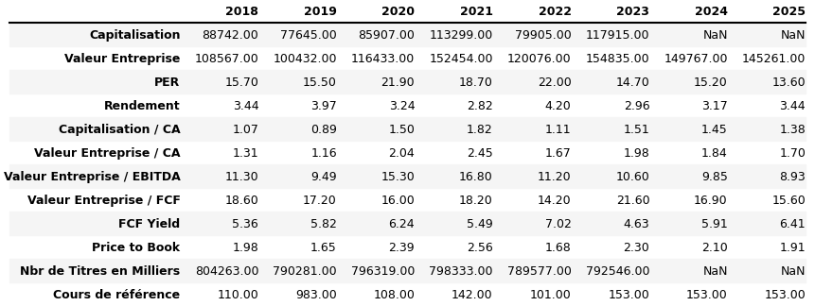
Array 1

Slide 4
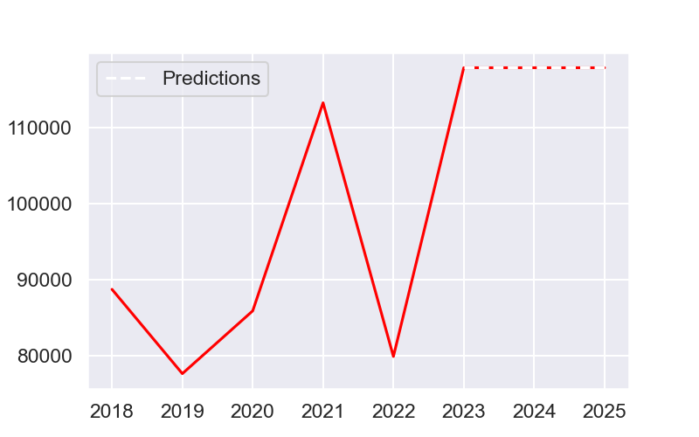
Capitalization

Slide 5
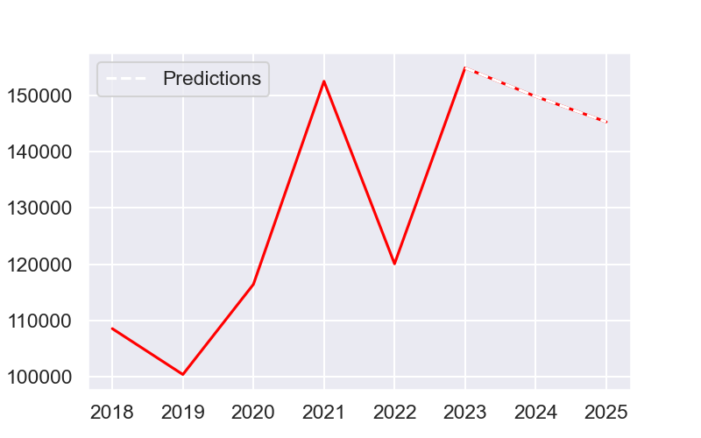
Business value

Slide 6
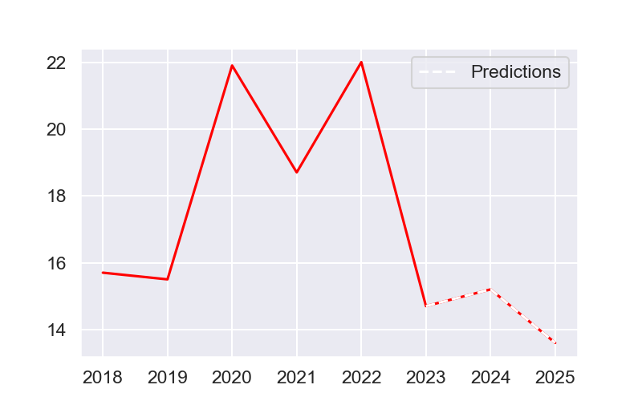
Per

Slide 7
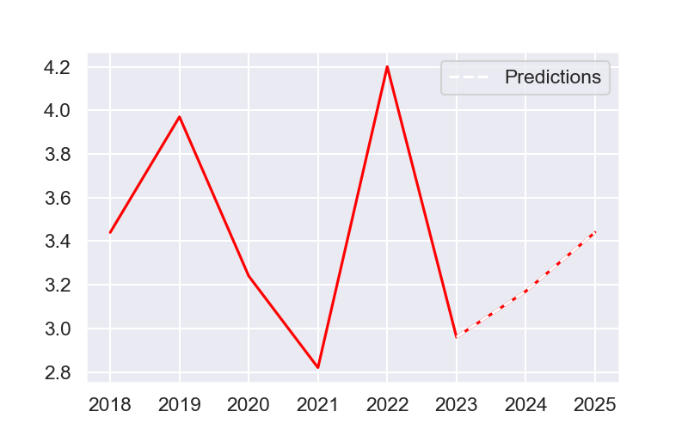
Yield

Slide 8
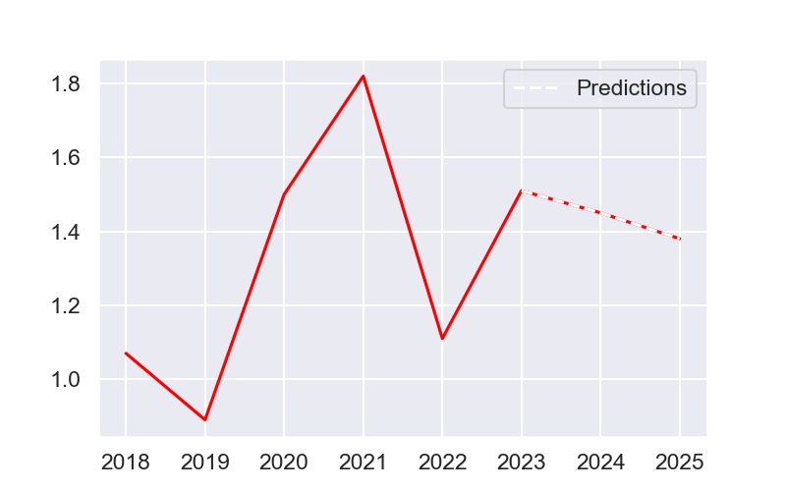
Capitalization / CA

Slide 9
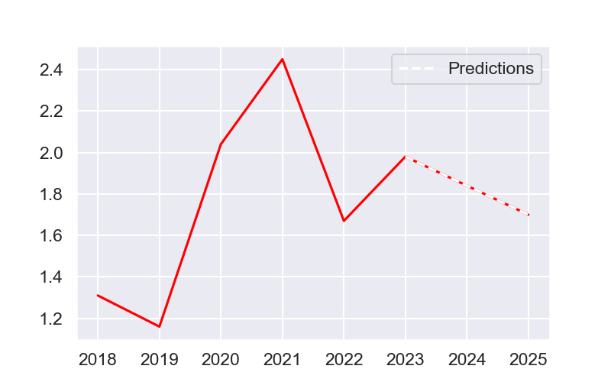
Business value / CA

Slide 10
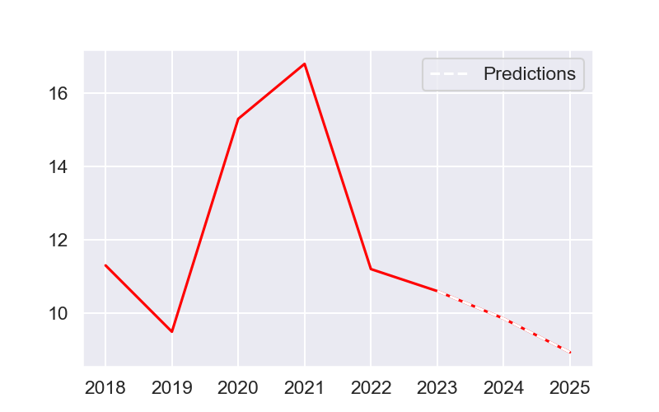
Business value / EBITDA

Slide 11
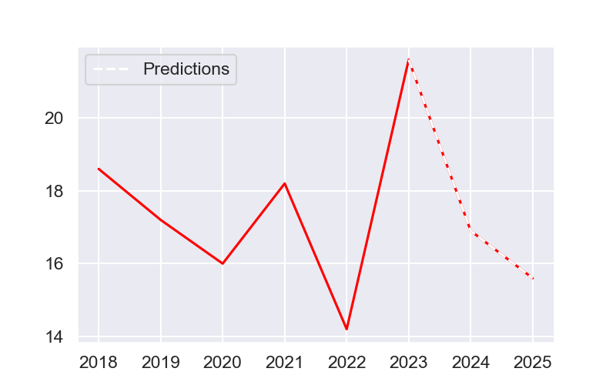
Business value / FCF

Slide 12
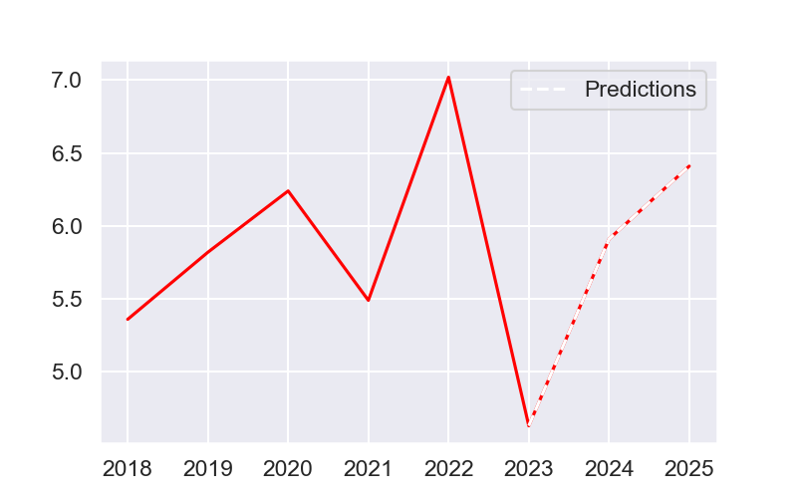
FCF Yield

Slide 13
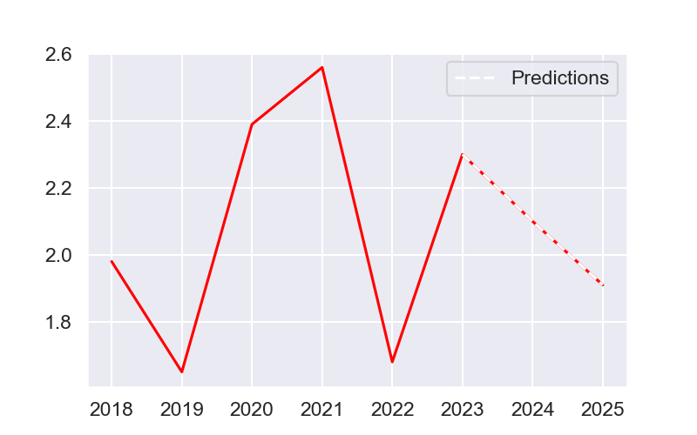
Price to book

Slide 14
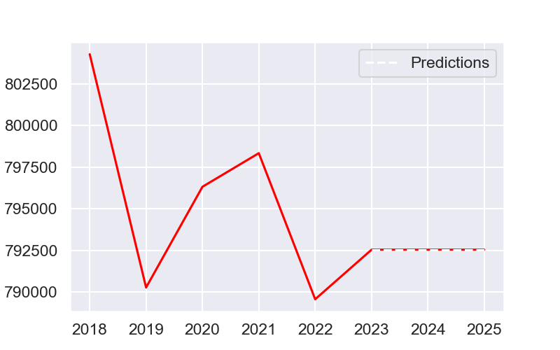
Nbr of titles in thousands

Slide 15
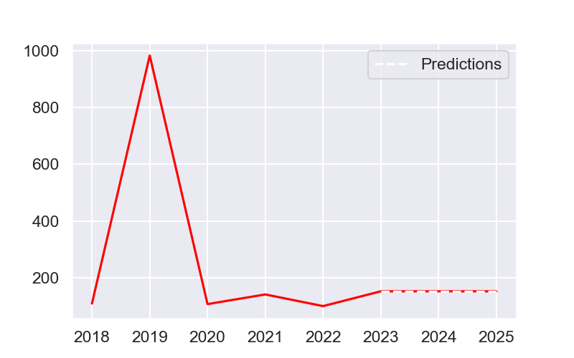
Reference course

Slide 16
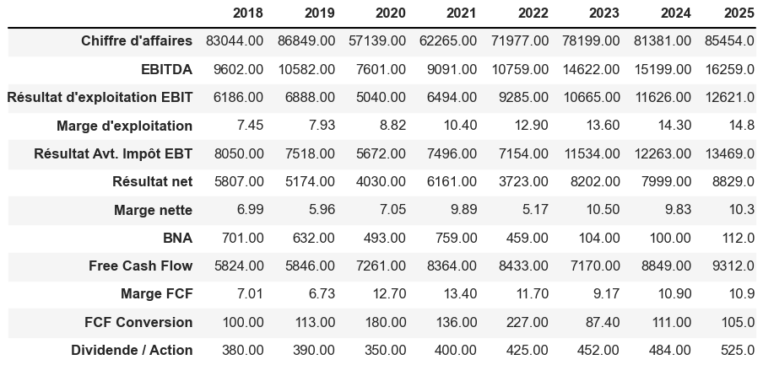
Array 2

Slide 17
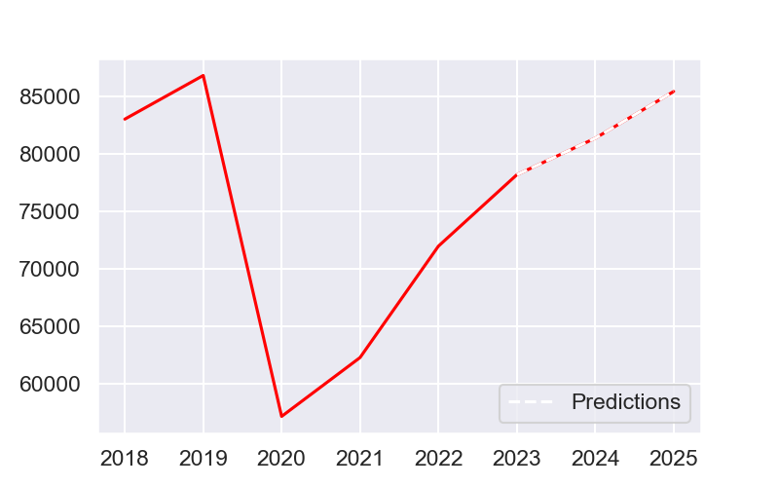
Turnover

Slide 18
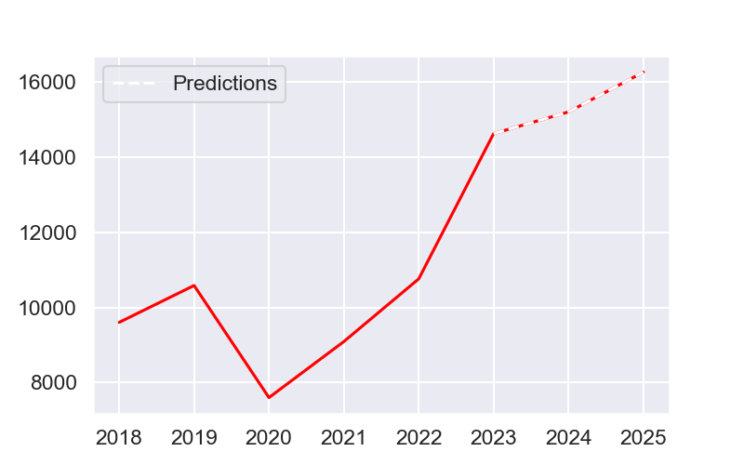
EBITDA

Slide 19
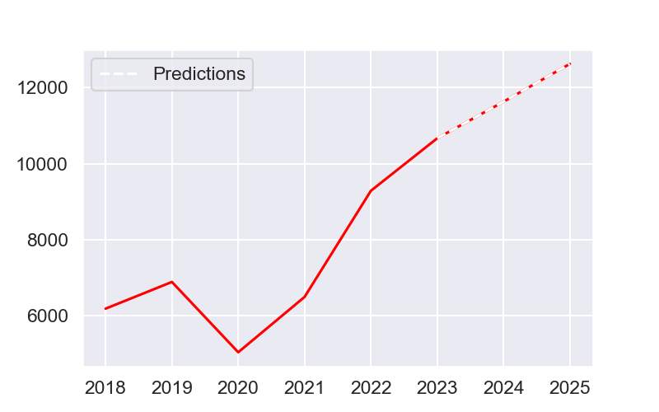
EBIT operating profit

Slide 20
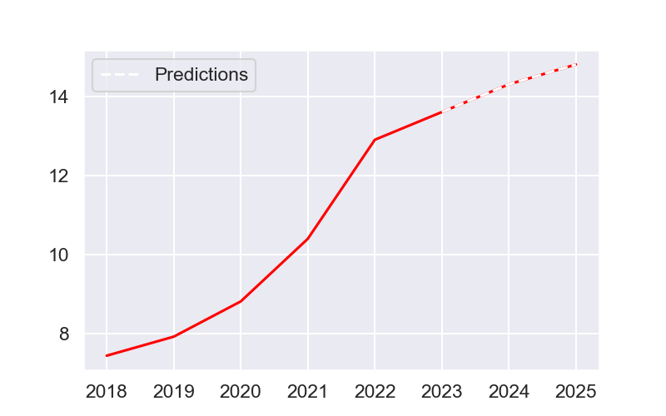
Operating margin

Slide 21
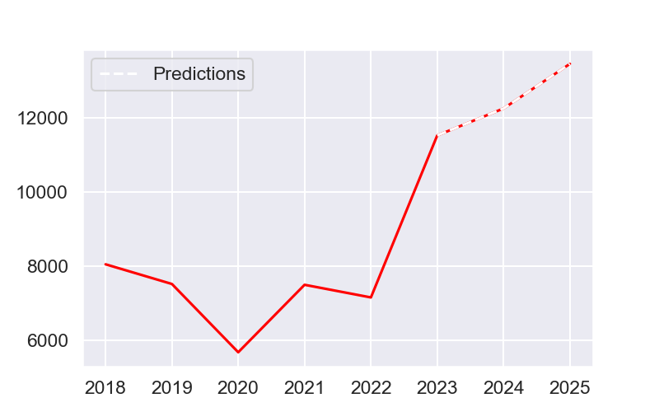
Result before.EBT tax

Slide 22
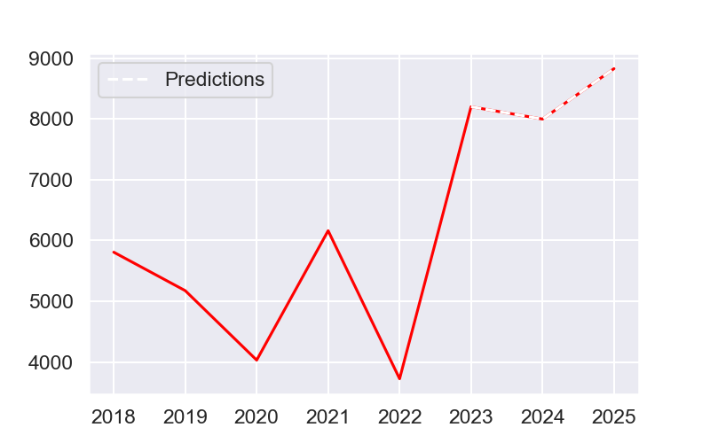
Net profit

Slide 23
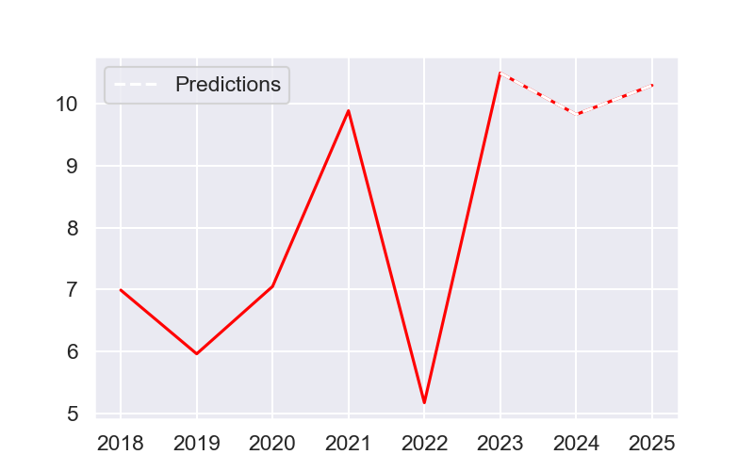
Net margin

Slide 24
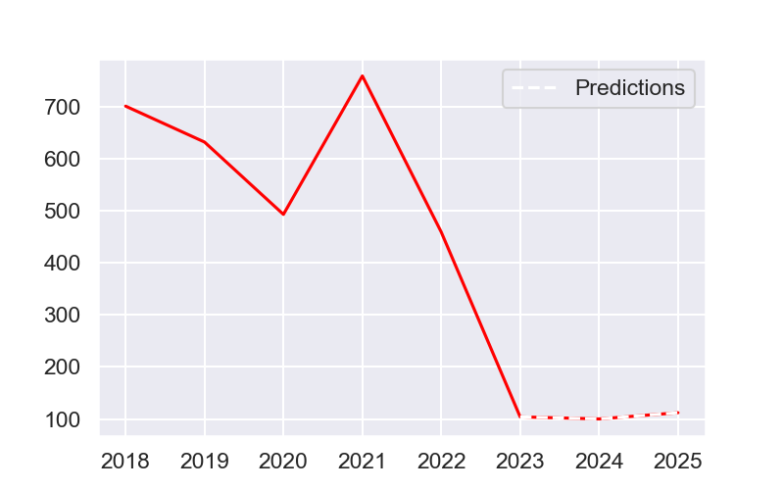
Bna

Slide 25
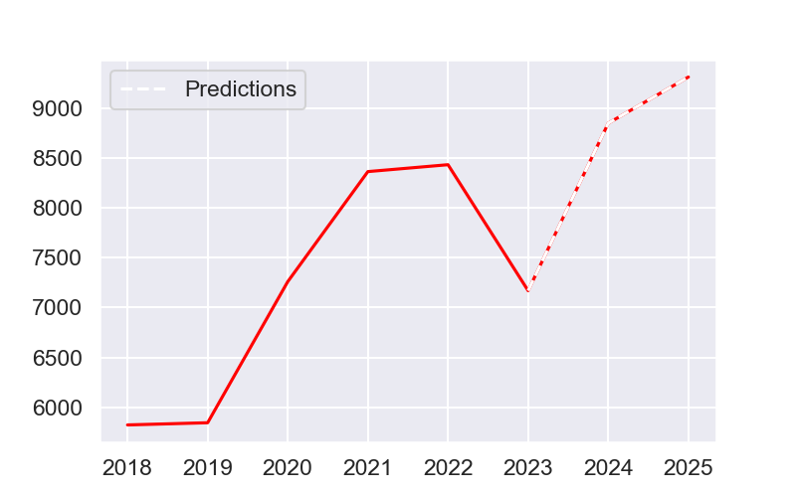
Free cash flow

Slide 26
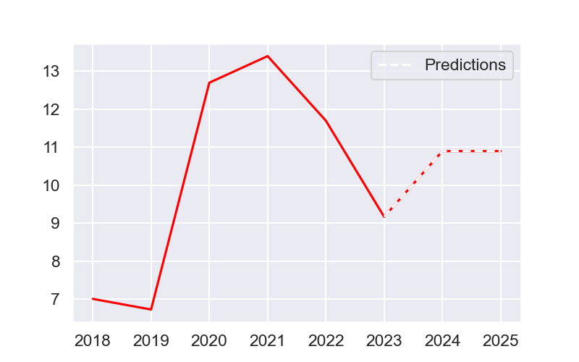
FCF margin

Slide 27
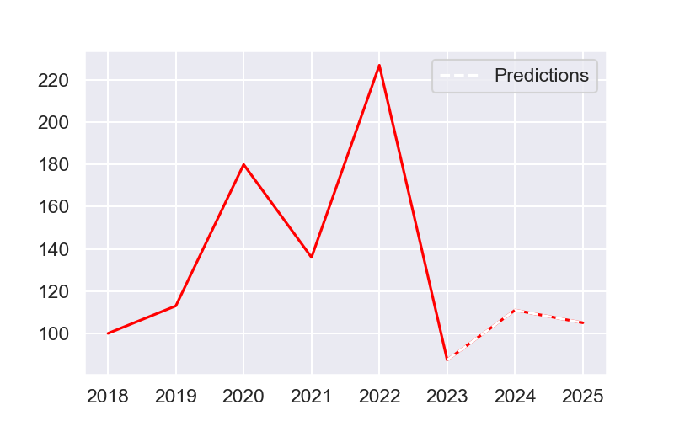
FCF Conversion

Slide 28
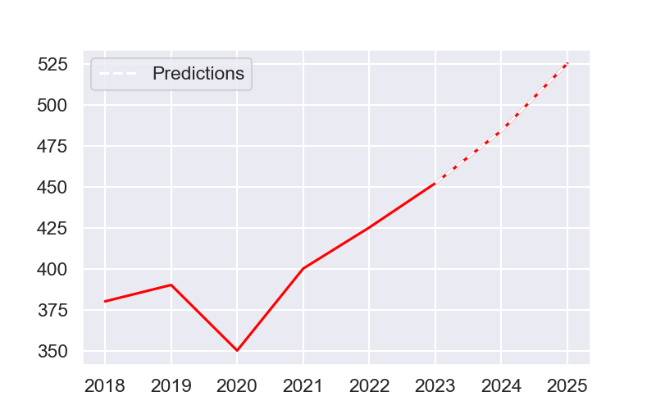
Dividend / Action

Slide 29
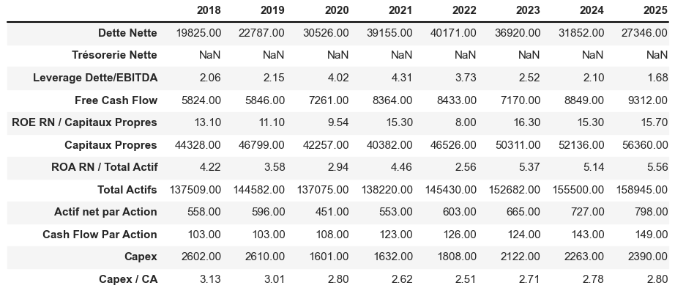
Array 3

Slide 30
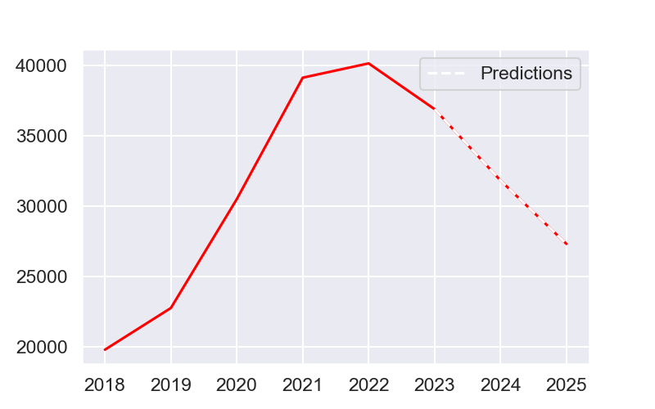
Net debt

Slide 31
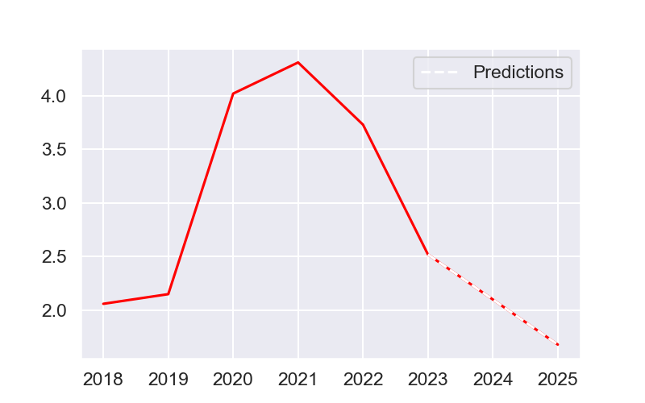
Debt/Ebitda Leverage

Slide 32
Free cash flow

Slide 33
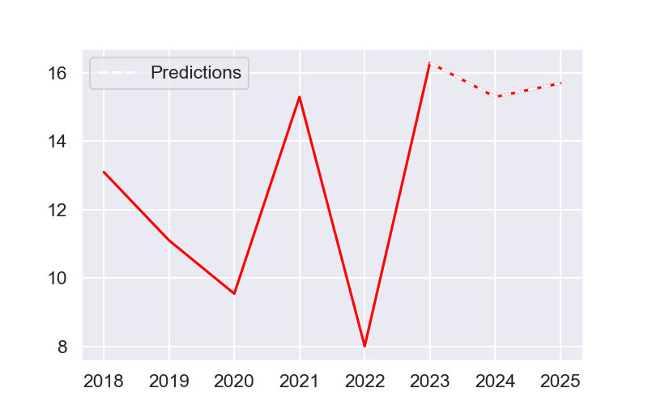
ROE RN / Equity

Slide 34
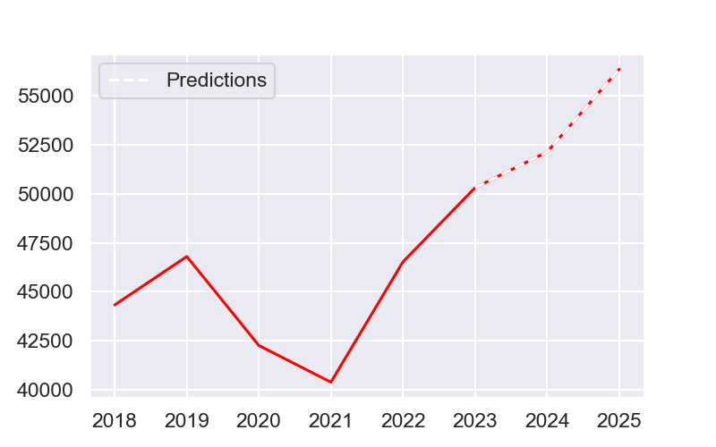
Equity

Slide 35
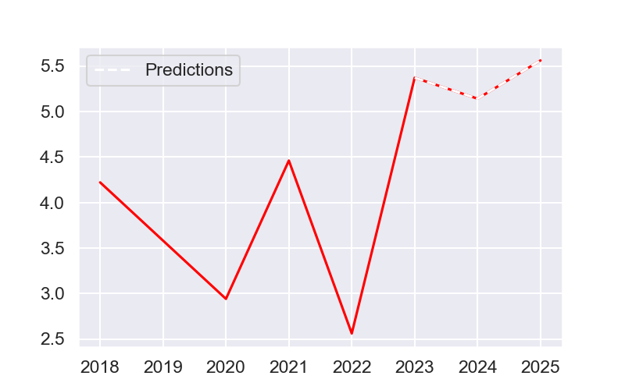
ROA RN / TOTAL Active

Slide 36
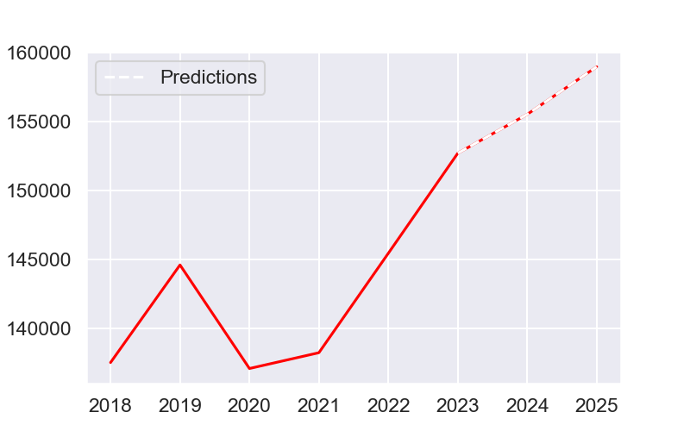
Total active

Slide 37
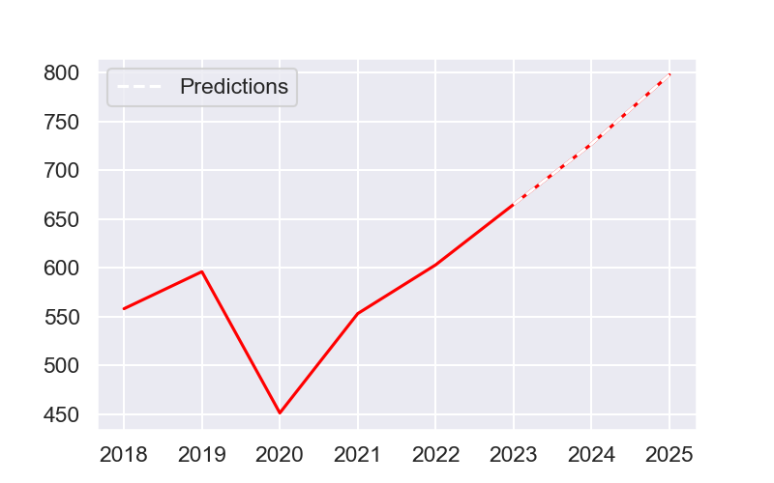
Net assets per share

Slide 38
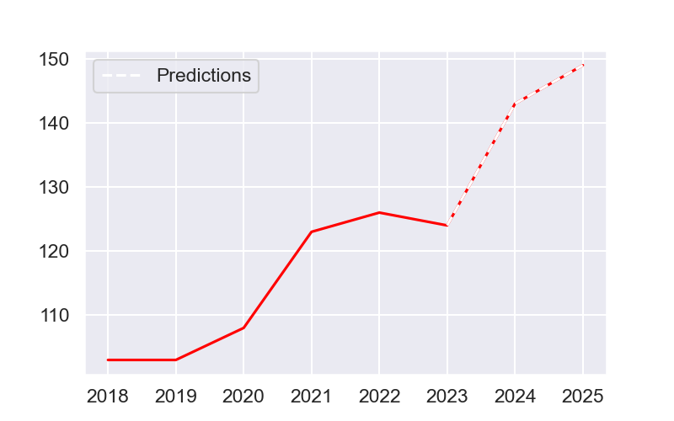
Cash flow by action

Slide 39
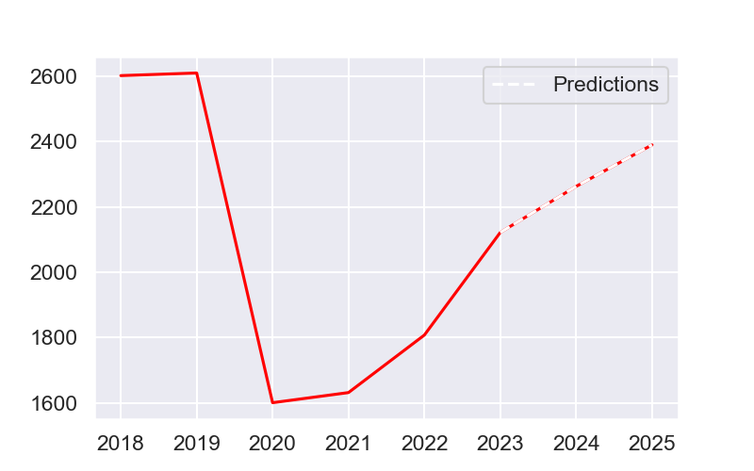
Capex

Slide 40
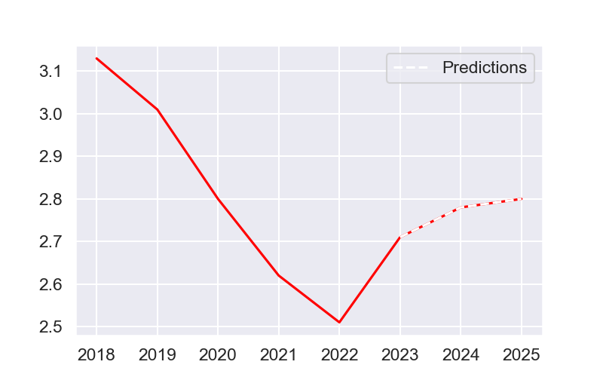
CAPEX / CA

Slide 41
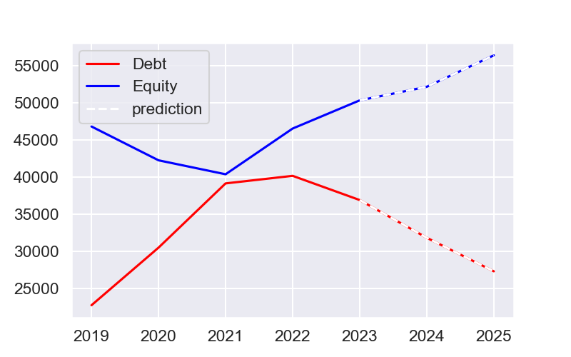
Equity versus debt

Slide 42
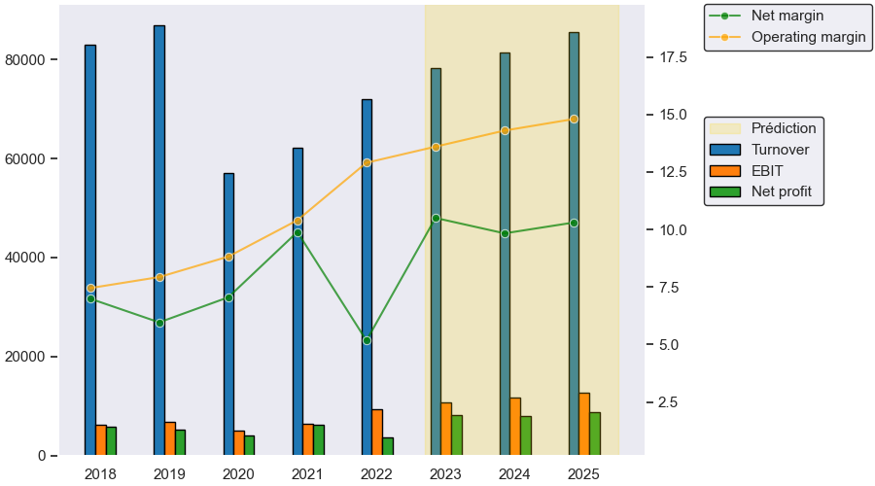
Evolution of the annual income statement

Slide 43
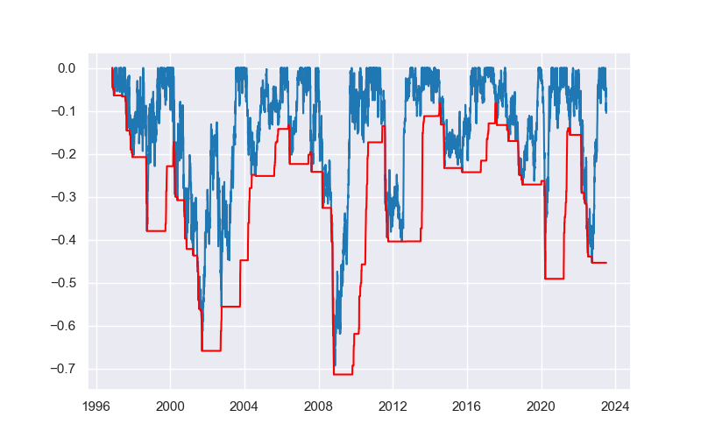
Maximum loss

Slide 44
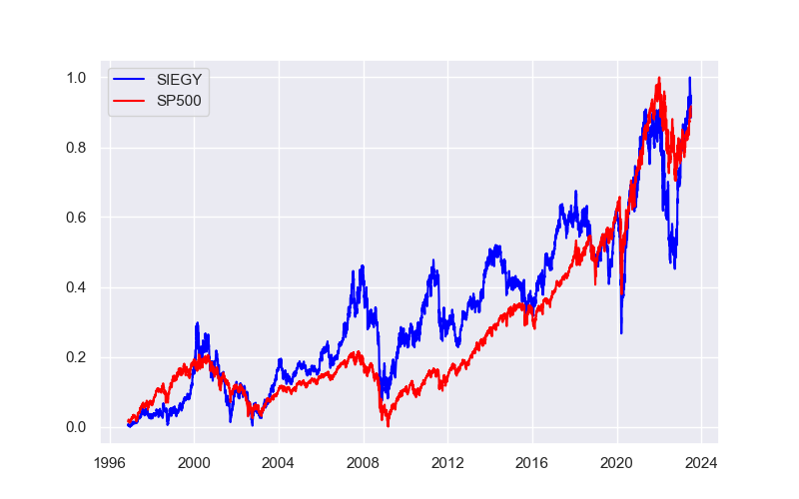
Normalized stocks price :SIEGY vs SP500

Slide 45
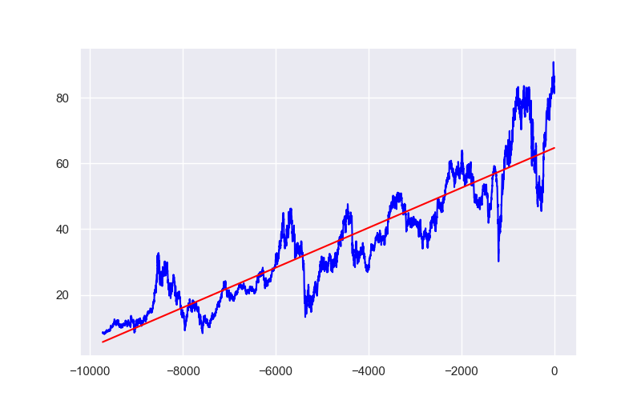
Linear regression

Slide 46
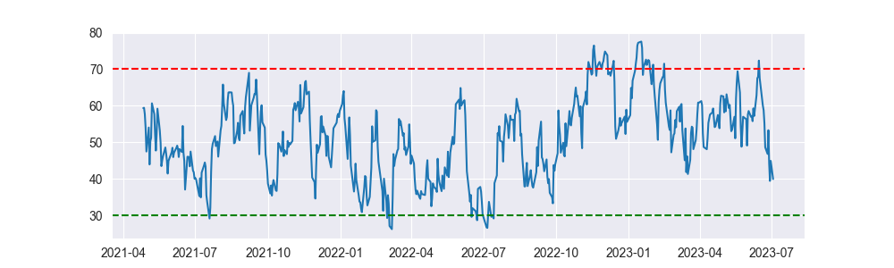
Relative Strength Index (RSI)

Slide 47
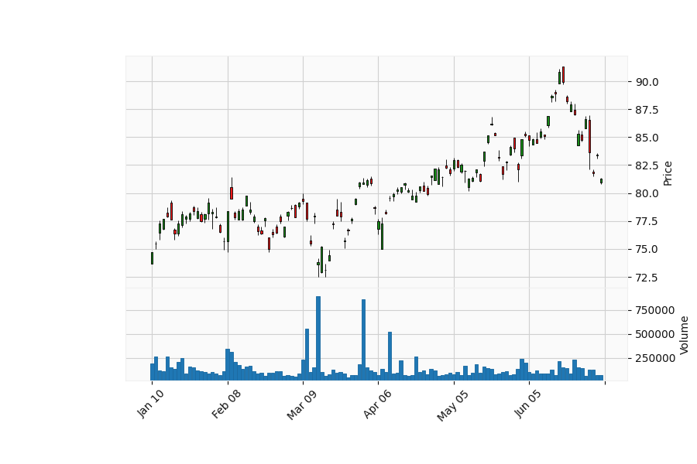
Last six months zoom

Slide 48
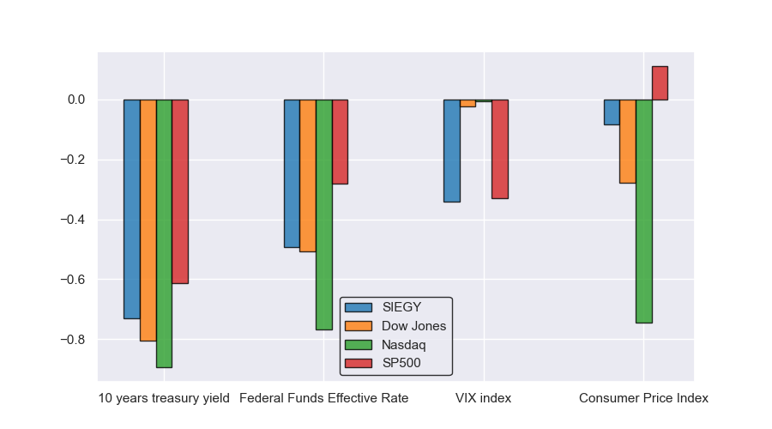
Correlations between various indexes and indicators

Slide 49
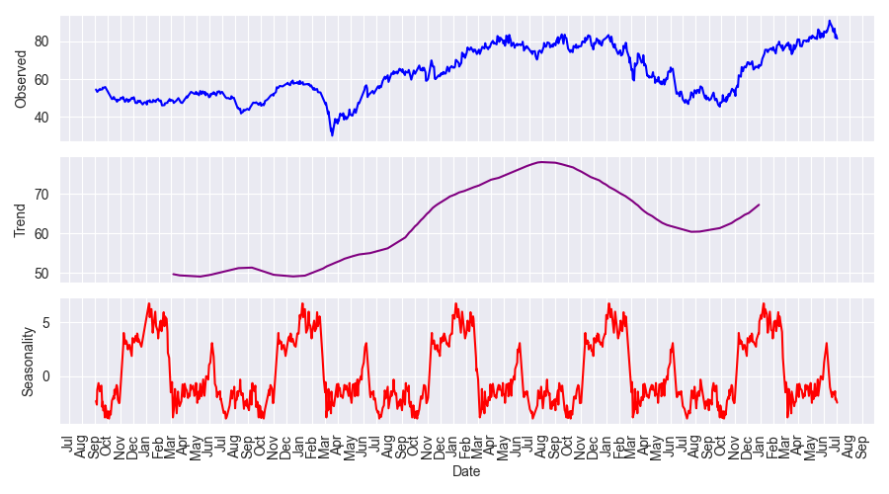
Breakdown of annual seasonality within the last years

Slide 50
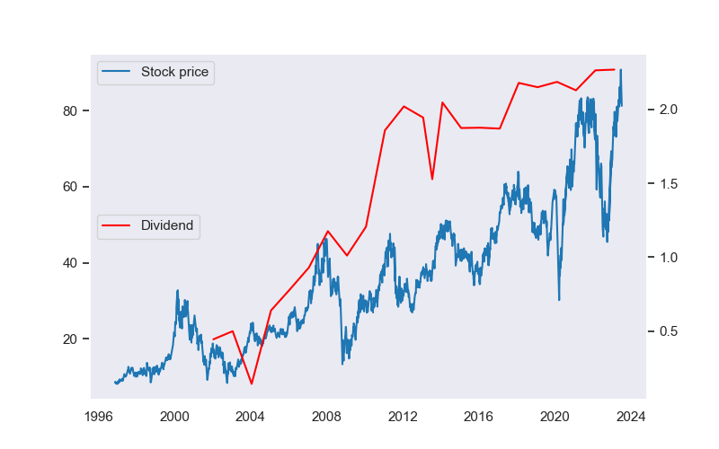
Price and dividends

Slide 51
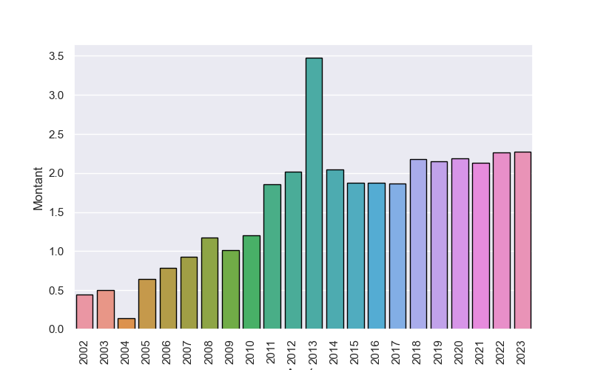
Dividend per year and per share

Slide 52
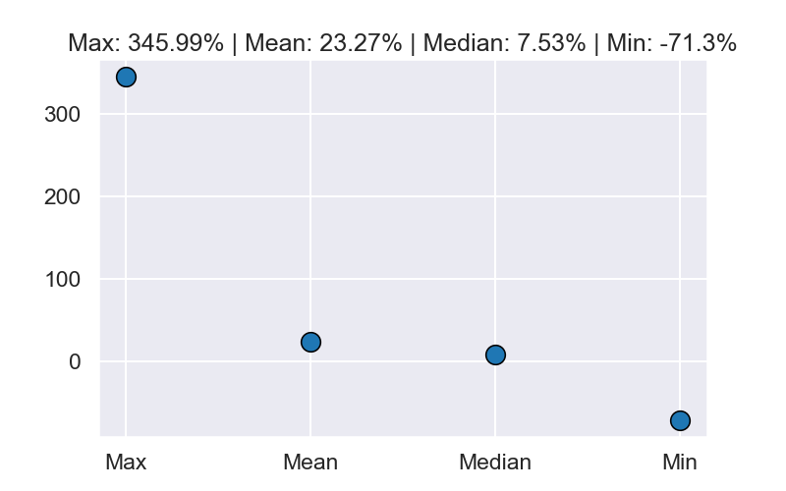
Dividend percentage changes statistics by year

Slide 53
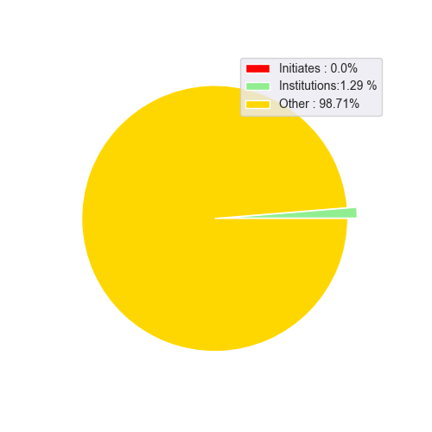
Investor distribution

Slide 54
Numbers and interestings informations.
The increase in average price over 27 years is 8.68% and 12.29% over the last 5 years. The average standard deviation a year is 2.22 and 2.29 over the last 5 years. The Sharpe and Sortino ratios are 0.246 and 0.0371 respectively respectively and 0.3381 and 0.0404 over the last 5 years. The three main institutional investors are, in decreasing order of detention: -Fisher asset management, LLC -Cullen Capital Management, LLC -Sit Investment Associates Inc. Date of this report: 2023-07-03

